Slide 1
Capstone Project - Predicting House Price

Slide 2
Introduction
In today's society, buying a house is an important investment channel. For most people, buying a house is the most important investment in life. How to buy a house at a reasonable price has become a problem that bothers people. When choosing a house, there are many considerations, not only the house type, location and other factors, but also the age of the house construction and the commercial facilities surrounding the house. This model hopes to find the most important characteristics of many factors that affect house prices through the analysis of the data, and also provide a reference price for each house. To help people make purchasing decisions;

Slide 3
Business Problem
When buying a house, there are many factors that need to be considered. We need to be able to find the factors that most affect the price of the house from many factors;
A model needs to be built to predict the price of a house based on the input parameters;

Slide 4
Interest
There are three types of people interested in this model：
Buyers: I hope to know the factors that affect house prices through the model, and also know whether the house they fancy is worth the money;
Sellers: Hope to know the real price of their house and the advantages of the house through the model;
Housing Intermediary staff: Hope to understand the customer's preferences through the model, and provide buyers and sellers with easier price suggestions;

Slide 5
Data acquisition and clearning
Each record in the database describes a Boston suburb or town. The data was drawn from the Boston Standard Metropolitan Statistical Area (SMSA) in 1970. The attributes are deﬁned as follows (taken from the UCI Machine Learning Repository1):
CRIM: CRIM per capita crime rate by town
ZN: proportion of residential land zoned for lots over 25,000 sq.ft.
INDUS: proportion of non-retail business acres per town
CHAS: Charles River dummy variable (= 1 if tract bounds river; 0 otherwise)
NOX: nitric oxides concentration (parts per 10 million)1https://archive.ics.uci.edu/ml/datasets/Housing12320.2. Load the Dataset 124 RM: average number of rooms per dwelling
AGE: proportion of owner-occupied units built prior to 1940
DIS: weighted distances to ﬁve Boston employment centers
RAD: index of accessibility to radial highways
TAX: full-value property-tax rate per $10,000 PTRATIO: pupil-teacher ratio by town
B: 1000(Bk−0.63)2 where Bk is the proportion of blacks by town
LSTAT: % lower status of the population

Slide 6
Data statisics
CRIM | ZN | INDUS | CHAS | NOX | RM | AGE | DIS | RAD | TAX | PTRATIO | B | LSTAT | PRICE
count | 506.000000 | 506.000000 | 506.000000 | 506.000000 | 506.000000 | 506.000000 | 506.000000 | 506.000000 | 506.000000 | 506.000000 | 506.000000 | 506.000000 | 506.000000 | 506.000000
mean | 3.613524 | 11.363636 | 11.136779 | 0.069170 | 0.554695 | 6.284634 | 68.574901 | 3.795043 | 9.549407 | 408.237154 | 18.455534 | 356.674032 | 12.653063 | 22.532806
std | 8.601545 | 23.322453 | 6.860353 | 0.253994 | 0.115878 | 0.702617 | 28.148861 | 2.105710 | 8.707259 | 168.537116 | 2.164946 | 91.294864 | 7.141062 | 9.197104
min | 0.006320 | 0.000000 | 0.460000 | 0.000000 | 0.385000 | 3.561000 | 2.900000 | 1.129600 | 1.000000 | 187.000000 | 12.600000 | 0.320000 | 1.730000 | 5.000000
25% | 0.082045 | 0.000000 | 5.190000 | 0.000000 | 0.449000 | 5.885500 | 45.025000 | 2.100175 | 4.000000 | 279.000000 | 17.400000 | 375.377500 | 6.950000 | 17.025000
50% | 0.256510 | 0.000000 | 9.690000 | 0.000000 | 0.538000 | 6.208500 | 77.500000 | 3.207450 | 5.000000 | 330.000000 | 19.050000 | 391.440000 | 11.360000 | 21.200000
75% | 3.677083 | 12.500000 | 18.100000 | 0.000000 | 0.624000 | 6.623500 | 94.075000 | 5.188425 | 24.000000 | 666.000000 | 20.200000 | 396.225000 | 16.955000 | 25.000000
max | 88.976200 | 100.000000 | 27.740000 | 1.000000 | 0.871000 | 8.780000 | 100.000000 | 12.126500 | 24.000000 | 711.000000 | 22.000000 | 396.900000 | 37.970000 | 50.000000

Slide 7
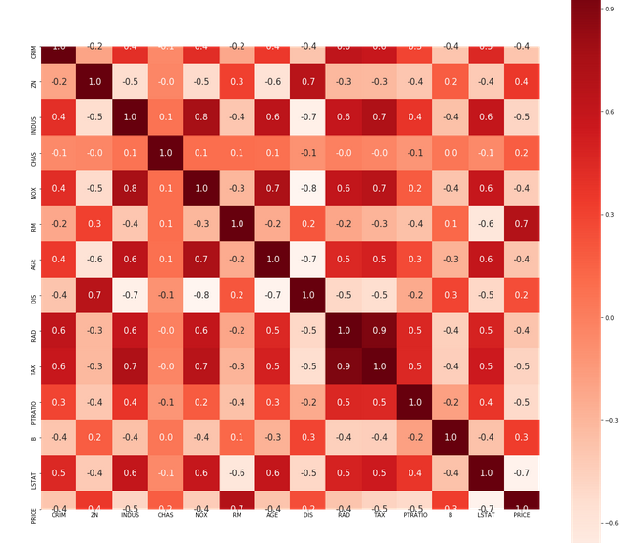
Correlation between the features

Slide 8
Model Selection
I will use below methods to create model，and compare which model works best；
linear regression
svm regression
Random Forest Regressor
XGBoost Regressor

Slide 9
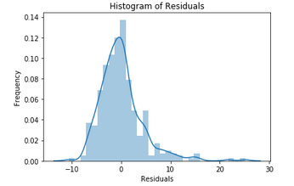
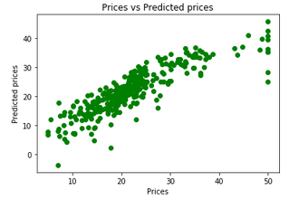
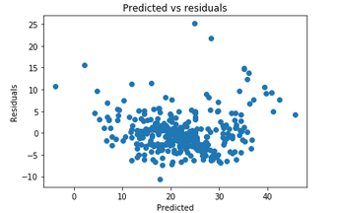
Linear Regression
Model Evaluation:
R^2: 0.7121818377409195
Adjusted R^2: 0.6850685326005713
MAE: 3.8590055923707407
MSE: 30.053993307124127
RMSE: 5.482152251362974

Slide 10
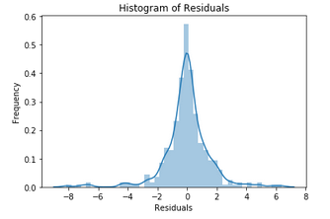
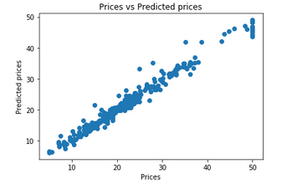
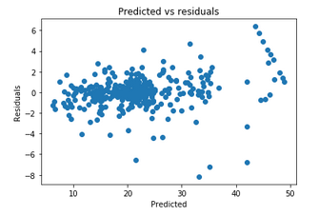
Random Forest Regression
Model Evaluation:
R^2: 0.9682860727519668
Adjusted R^2: 0.9670734814160126
MAE: 0.9799717514124296
MSE: 2.387133615819209
RMSE: 1.5450351503506996

Slide 11
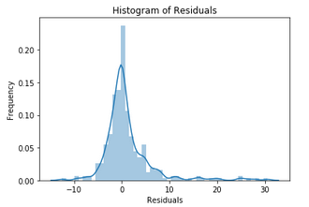
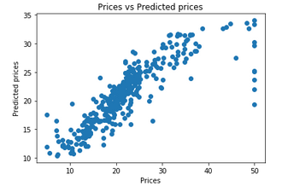
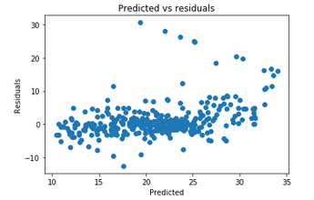
SVM Regression
Model Evaluation:
R^2: 0.6419097248941195
Adjusted R^2: 0.628218037904777
MAE: 2.9361501059460293
MSE: 26.953752101332935
RMSE: 5.191700309275655

Slide 12
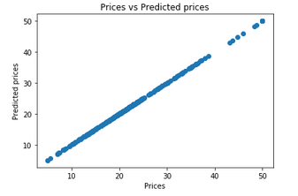
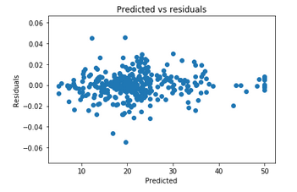
XGBoost Regression
Model Evaluation:
R^2: 0.8582821355168694
Adjusted R^2: 0.8449319019061396
MAE: 2.5252377980633782
MSE: 14.798189652958767
RMSE: 3.8468415164858

Slide 13
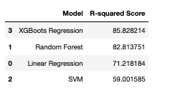
Conclusion
Built useful models to predict House price
The best model is XGBoots model. The R-Squared Score is 85.82%
Visualization is useful for data analysis.

